Slide 1
BINOMIAL HEAP
Nishant Bhat
Abhijit Gawai
Shyam Kawale
Himanshu Pande
Bhargav Pawar
DEFINITION

Slide 2
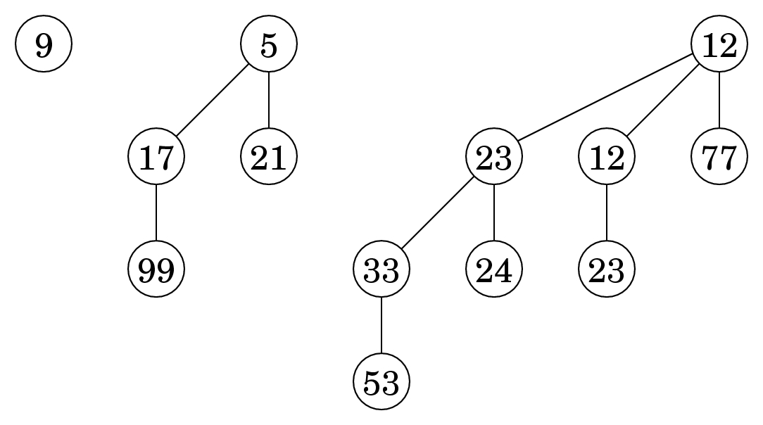
What is a binomial Heap?
Binomial Heap is a collection of Binomial Trees
It is an extension of binary heap providing faster union or merge operation together with other operations than Binary Heap.
Binomial heaps are represented by using noding that have the following fields:-degree,child,link and data

Slide 3
Properties
A Binomial Tree of order k has following properties.
a) It has exactly 2^{k} nodes.
b) It has depth as k.
c) There are exactly ^{k}C_{i} nodes at depth i for i = 0, 1, . . . , k.
d) The root has degree k and children of root are themselves binomial trees with order k-1,k-2…..0 from left to right.

Slide 4
BINOMIAL HEAP
OPERATIONS

Slide 5
UNION Operation
--Creating heap H that is union of H1 and H2.
--Time Complexity- O(logn).
ALGORITHM:
1) The first step is to simply merge the two Heaps in non-decreasing order of degrees.
Case 1: Orders of x and x->next are not same, we simply move ahead. In following 3 cases orders of x and x->next are same. Case 2: If the order of x->next->next is also same, move ahead. Case 3: If the key of x is smaller than or equal to the key of next-x, then make x->next as a child of x by linking it with x. Case 4: If the key of x is greater, then make x as the child of next.

Slide 6
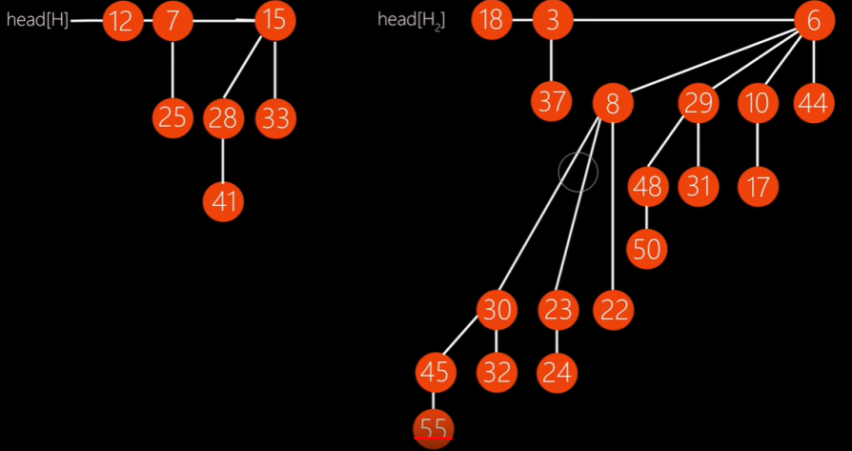
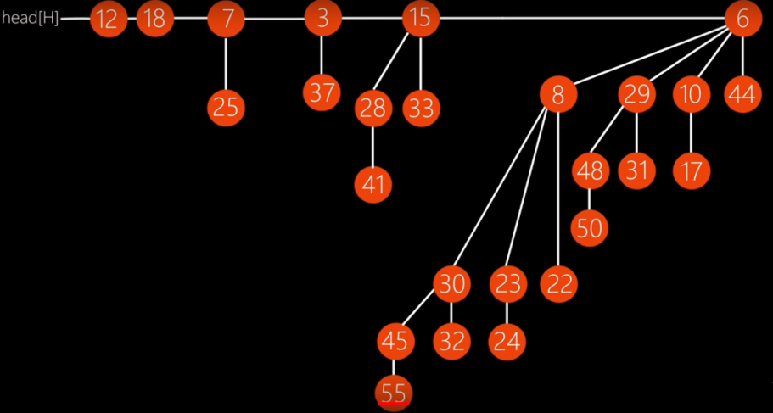
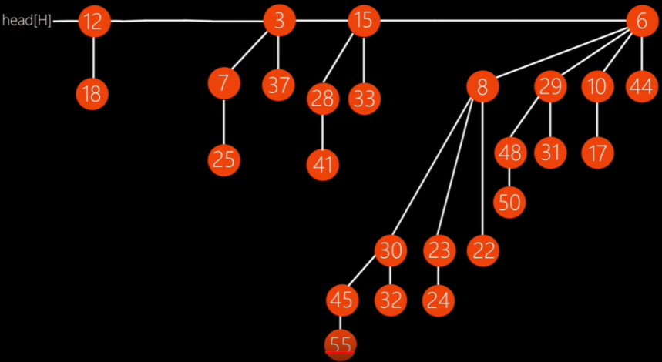
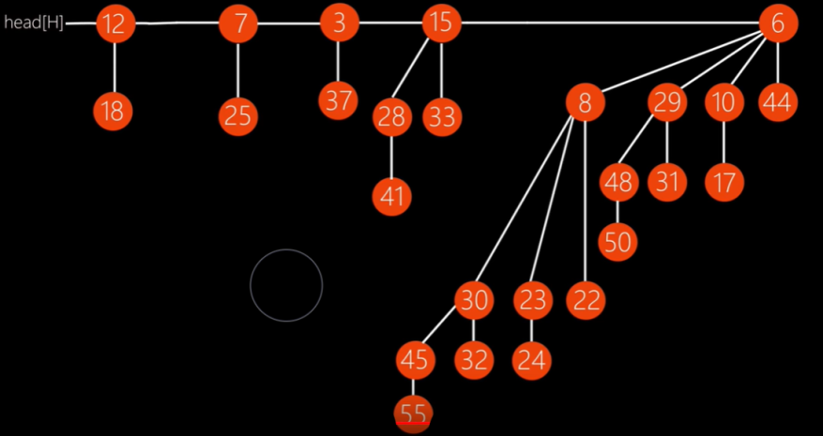
union(H1,H2)
merging
Initial Heap
Orders of x and x->next are same
(key of x) <= (key of next-x),
so make x->next as a child of x
(key of x)>(x->next),
so make x as the
child of next.
(order of x)= (order of x->next->next) , move ahead.

Slide 7
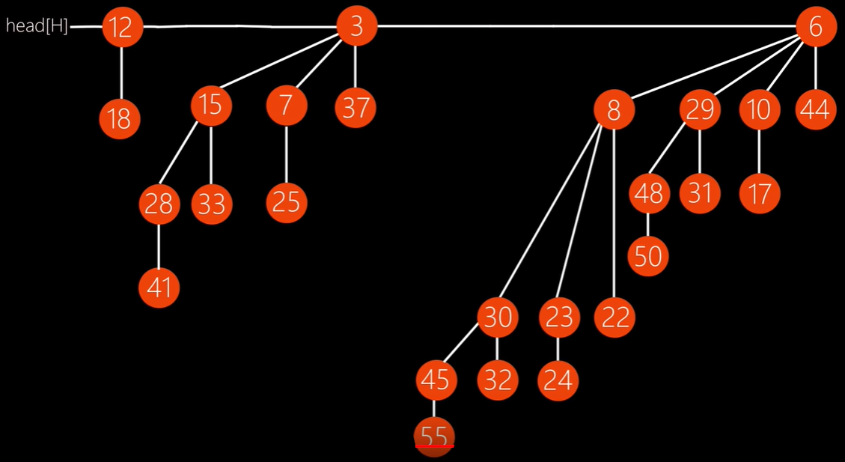
(key of x) <= (key of next-x),
so make x->next as a child of x
Time Complexity- O(logn).

Slide 8
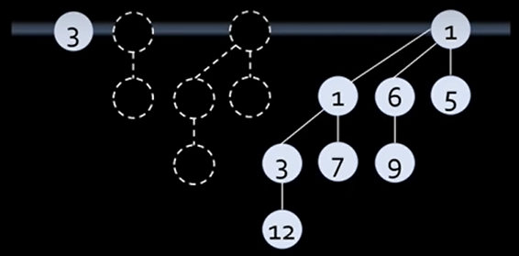
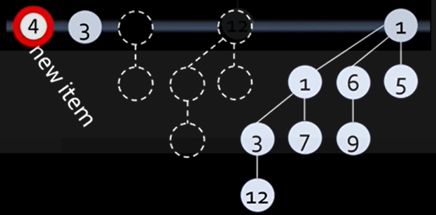
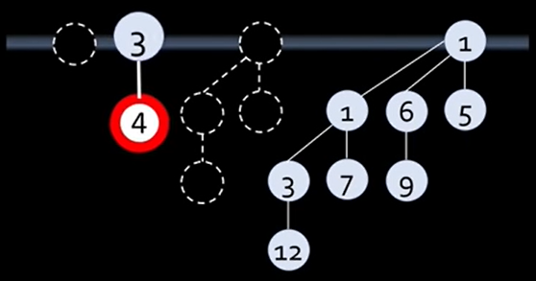
insert(H,key)
insert(H, k): Inserts a key ‘k’ to Binomial Heap ‘H’. This operation first creates a Binomial Heap with single key ‘k’, then calls union on H and the new Binomial heap.
Initial Heap
Adding a new item
Time Complexity -O(log(n))
Since there are log(n) trees, which might all be involved in merging
Union operation

Slide 9
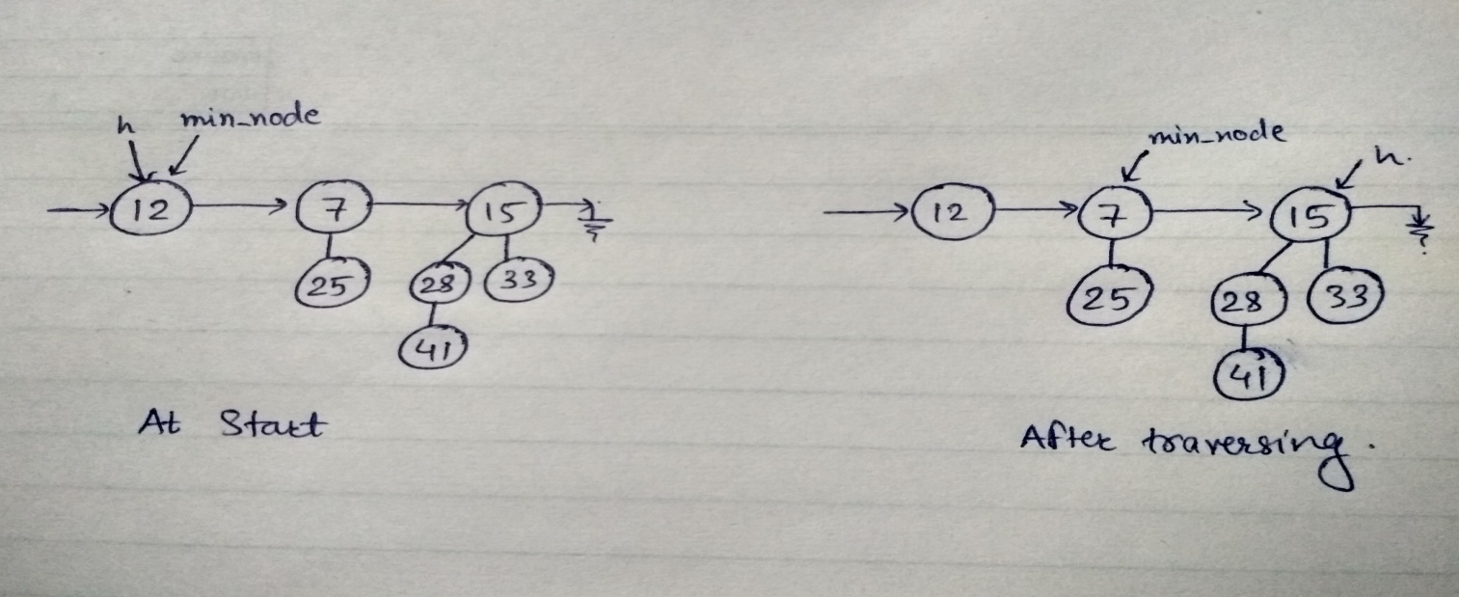
getmin(H)
getMin() gets executed by traversing the list of root of Binomial Trees and return the minimum key.
Time Complexity –log(n)
It can be optimized to O(1) by maintaining a pointer to minimum key root.

Slide 10
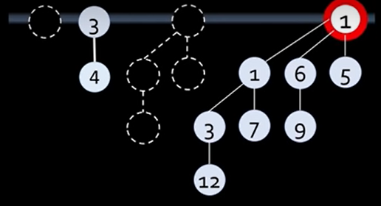
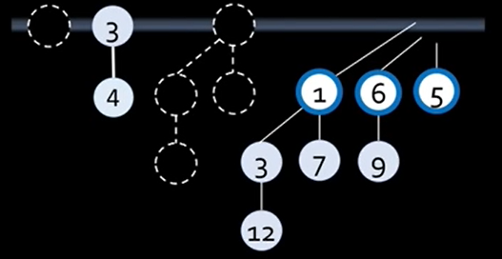
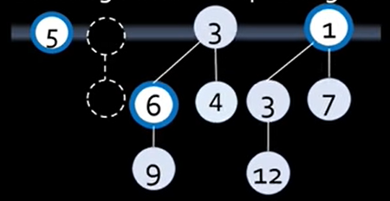
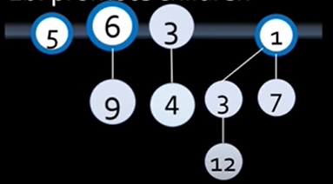
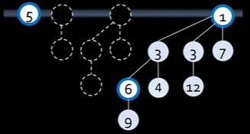
popMin(H)
Popping least key from heap
Initial Heap
Popping least key
Merge tree of equal degree
Promote Children
Time Complexity - O(3log(n))
O(log(n)) to find minimum key
O(log(n)) to promote children
O(log(n)) to merge trees
Merge tree of equal degree

Slide 11
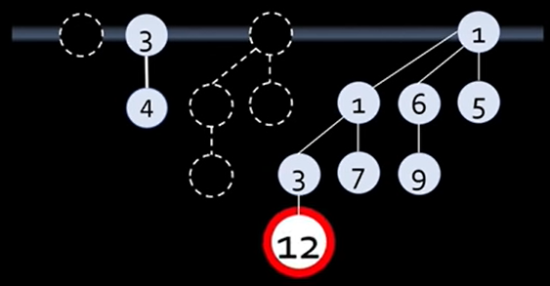
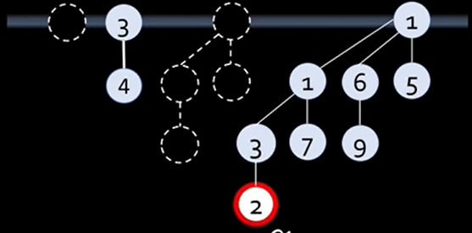
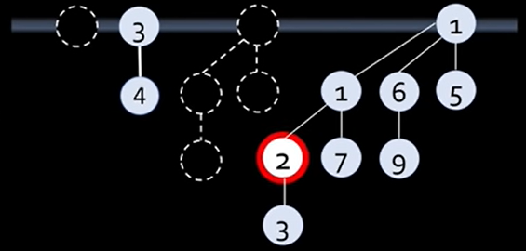
decreaseKey(H,key1,key2)
Decreasing key value
Initial Heap
Key value decreased
Time Complexity -O(log(n))
Bubbling up from bottom to top of largest binomial tree
Bubble up

Slide 12
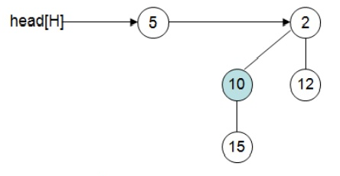
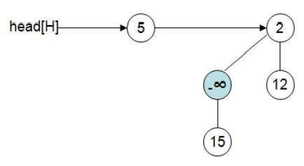
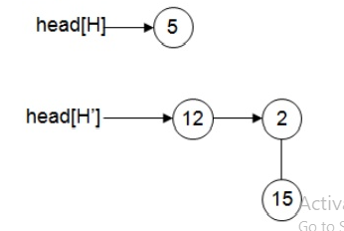
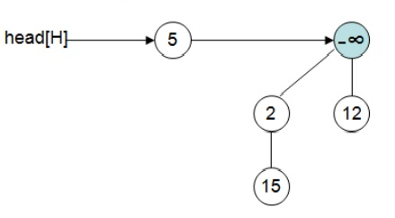
delete(H,key)
delete operation first reduces the key to minus infinite, then calls extractMin().
Initial heap
2nd step
3rd step
4th step

Slide 13
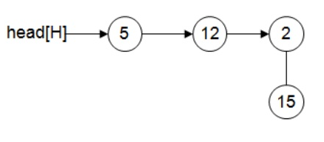
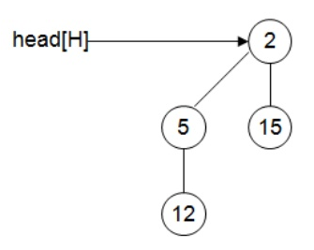
5th step
4th step
6th step

Slide 14
BINOMIAL HEAP
Comparison with Binary Heap

Slide 15
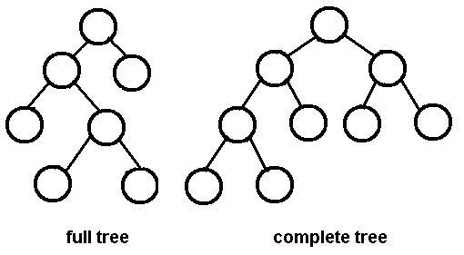
What exactly is a binary heap?
Binary heap is a binary tree which is complete. Except the last level, all its level are completely filled.
It is either a Min Heap or a Max Heap.
Min Heap: Value of parent/root node is less than or equal to either of its node.
Max Heap: Value of parent/root node is greater than or equal to either of its node.

Slide 16
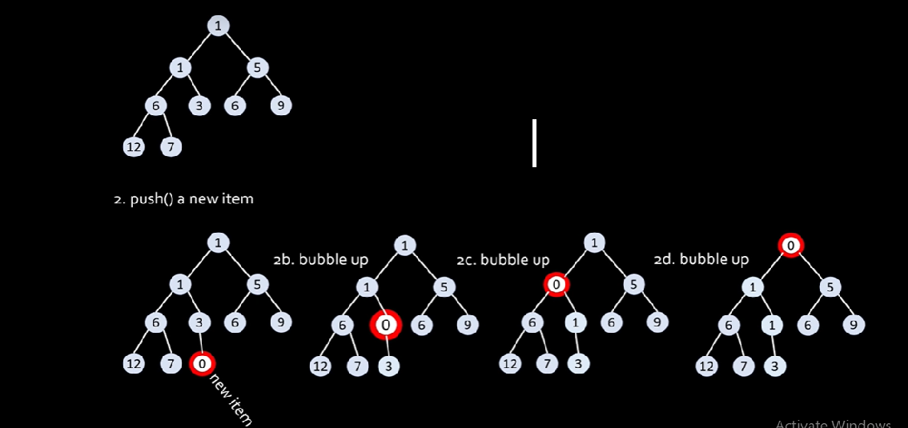
Operations in binary heap

Slide 17
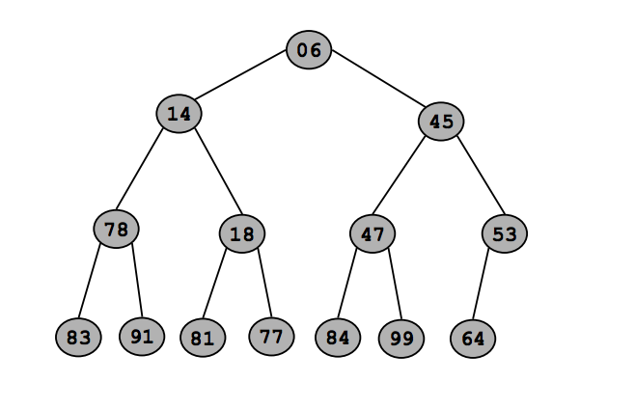
Comparing time complexities..
TIME COMPLEXITY | BINARY HEAP | BINOMIAL HEAP
INSERTION | O (log n) | O (log n)
FIND MIN | O (1) | O (log n)
EXTRACT MIN | O (log n) | O (log n)
UNION | O (n) | O (log n)
DELETION | O (log n) | O (log n)

Slide 18

BINOMIAL HEAP
APPLICATION

Slide 19
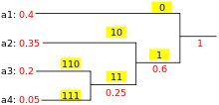
HUFFMAN CODING
Used for lossless data compression with minimum redundant coding technique.
Goal is to minimize the length of code for a particular data.
Symbol | Code
a1 | 0
a2 | 10
a3 | 110
a4 | 111

Slide 20
ROAM ALGORITHM
1. Real-time Optimally Adapting Mesh(ROAM) is a continuous level of detail algorithm that optimizes terrain meshes.
2. On modern computers it is dynamically decided the Level Of Detail(LOD) at a particular part of the frame.
3. This technique is used by graphics programmers in order to produce high quality displays while being able to maintain real-time frame rates.
4. It works by splitting triangles where more detail is needed and merging them where less detail is needed. The algorithm assigns each triangle in the terrain a priority.
5. The algorithm uses two priority queues, one for triangles that can be split and another for triangles that can be merged.

Slide 21
BANDWIDTH MANAGEMENT
1. Priority queuing can be used to manage limited resources such as bandwidth on a transmission line from a network router.
2. In event of outgoing traffic, other transmission can be halted due to insufficient bandwidth to do some high priority transmission.
3. Usually a limitation (policer) is set to limit the bandwidth that traffic from the highest priority queue can take, in order to prevent high priority packets from choking off all other traffic.

